Slide 1

Spreadsheet Best Practices
Rebecca Olson, Business and Social Science Informationist
Rebecca.olson@uc.edu or ASKDATA@uc.edu
Research & Data Services, UC Libraries

Slide 2
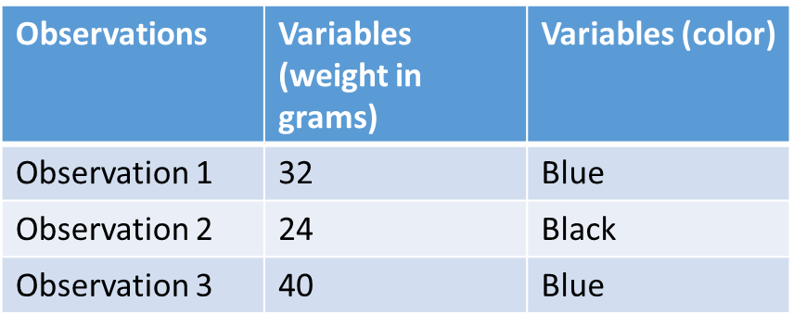
Structure your data
Variables in Columns
Observations in rows – 1 observation per row
1 piece of information per cell
Leave data raw – make a copy to work from (make a new tab)
Export cleaned data to text based format (CSV, Tab)

Slide 3
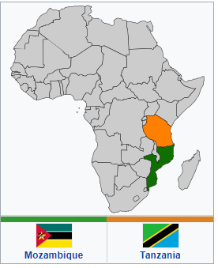
SAFI Data Set
https://en.wikipedia.org/wiki/Mozambique%E2%80%93Tanzania_relations
Studying African Farmer-Lead Irrigation
Teaching version of data
See Variables/questions at https://figshare.com/articles/SAFI_Survey_Results/6262019
SAFI_Messy
CITATION: Woodhouse, Philip; Veldwisch, Gert Jan; Brockington, Daniel; Komakech, Hans C.; Manjichi, Angela; Venot, Jean-Philippe (2018): SAFI Survey Results. doi:10.6084/m9.figshare.6262019.v1

Slide 4


Formatting your data
Formatting is just for looks. It’s program specific, not data specific.
Don’t use it to convey information about the data or to structure the data!
Good Data Management Tip: Name Your Variables Smartly
Use abbreviations that make sense long term.
Avoid special characters
Use the Pothole(Snake Case) Test_Results_1a or Camelback (Camel Case) TestResults1a formats
Good Name | Good Alt | Avoid
Max_temp | MaxTemp | Maximum Temp
Precipitation | Precipitation_mm | precmm
Sex | Sex | M/F
Weight | Weight | w.
First_observation | Observation_01 | 1st Obs.

Slide 5
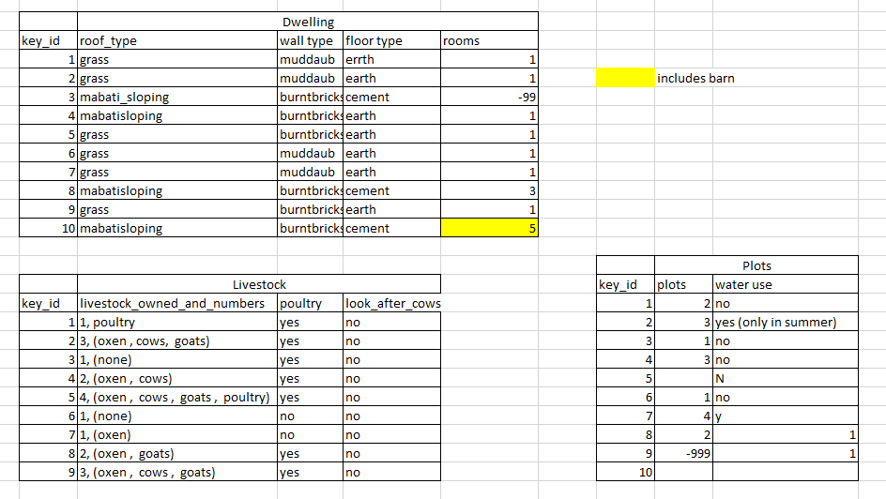
Where should formatting be cleaned up?
Notes:
Answers:
Dwelling:
Roof_type: no spaces for #4, #8, #10
Wall Type: no underscore for variable name
Floor Type: misspellings for earth
Rooms: negative number (may be a NULL), color indicating a barn.
-issue because – not machine readable.
Livestock:
Livestock_owned_and_numbers : multiple variables in one cell
Poultry
Plots:
Plots: some blanks, some negative
Water use: no underscore in title, N and No, Y and Yes, conditional, numbers – a mess

Slide 6

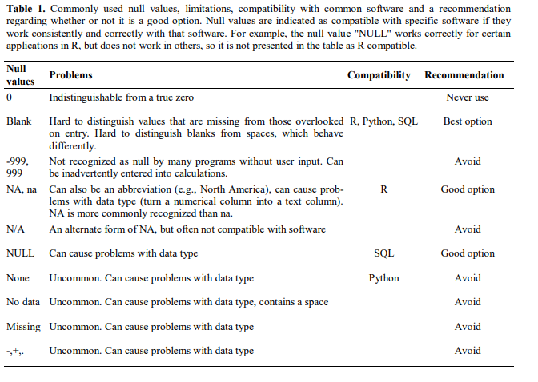
Null/Zero Values
https://ojs.library.queensu.ca/index.php/IEE/article/view/4608

Slide 7
Metadata
Metadata
Descriptive
Administrative
Structural
Contextual information about the data, stored with the data
Examples – full description of the fields, full questions and answers
Store it in a txt file with the CSV.
Reproducibility/Clarity
SAFI_clean
What Metadata Is needed?

Slide 8

Dates
Regional variation
Solution? Split dates into separate cells.
SAFI_Dates
Formulas to use to the entire column:
=MONTH()
=DAY()
=YEAR()

Slide 9

QA for Spreadsheets
Can set parameters for data entry to validate upon entry
Restrict data to format, date/numeric range, list
Data Tab- Data Tools – Data Validation(or Validation Tools)
Allow: Whole number, List, etc.

Slide 10
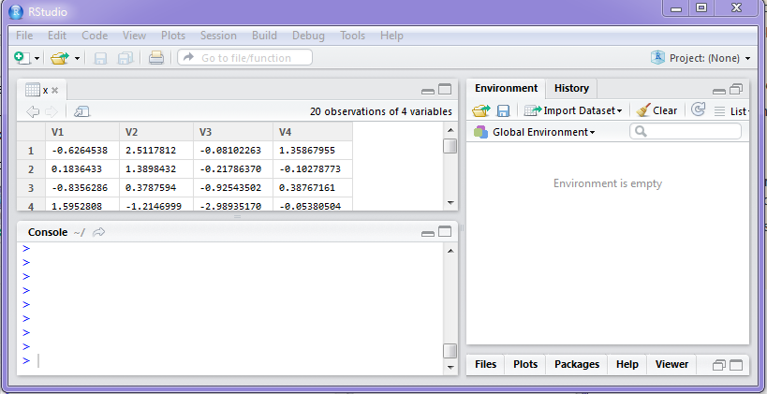
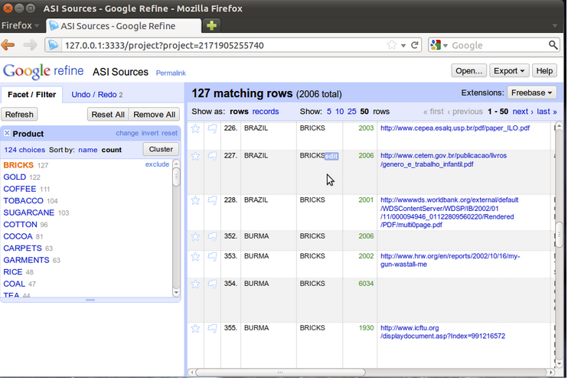


Exporting Data
Excel formatting - .xls, .xlsx
Why change to .csv?

Slide 11
Acknowledgment
This presentation was based on the Spreadsheets for Social Sciences workshop from Data Carpentry. https://datacarpentry.org/spreadsheets-socialsci/

Slide 12
Thank you!
ASKDATA@ UC.EDU /Rebecca.Olson@uc.edu
Collaborative Research using the Open Science Framework,October 22, 2019 10-11:00 AM (Data Viz Lab)
Cleaning Data with Open Refine Workshop, October 28, 10-12
Writing a Data Management Plan, November 05, 2019, 10-11 (Data Viz Lab)
https://webapps2.uc.edu/ce/facdev/Workshops/Index/UCL_P

